Slide 1
Introduction to Modern Symmetric key ciphers
t

Slide 2
Modern Block ciphers
A symmetric-key modern block cipher encrypts an n-bit block of plaintext or decrypts an n-bit block of ciphertext. The encryption or decryption algorithm uses a k-bit key.

Slide 3
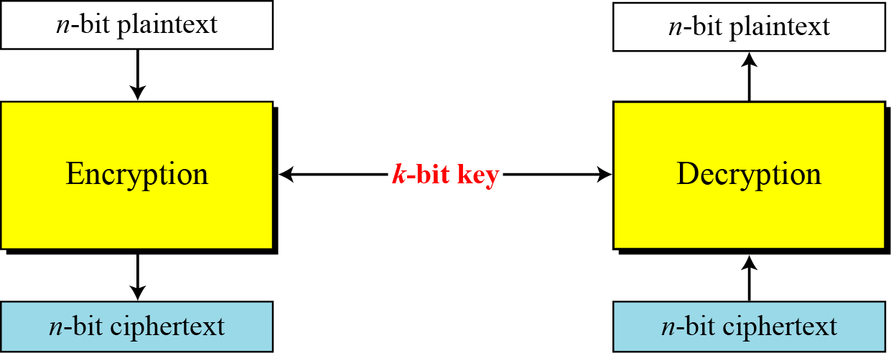
Modern Block ciphers…

Slide 4
Modern Block ciphers…
Example
How many padding bits must be added to a message of 100 characters if 8-bit ASCII is used for encoding and the block cipher accepts blocks of 64 bits?

Slide 5
Modern Block ciphers…
Example
How many padding bits must be added to a message of 100 characters if 8-bit ASCII is used for encoding and the block cipher accepts blocks of 64 bits?
Solution
Encoding 100 characters using 8-bit ASCII results in an 800-bit message. The plaintext must be divisible by 64. If | M | and |Pad| are the length of the message and the length of the padding,

Slide 6
Substitution or Transposition
A modern block cipher can be designed to act as a substitution cipher or a transposition cipher.
Which one do you think is better? Why?

Slide 7
Substitution or Transposition…
Let us take an example
Suppose that we have a block cipher where n = 64. If there are 10 1’s in the ciphertext, how many trial-and-error tests does Eve need to do to recover the plaintext from the intercepted ciphertext in each of the following cases?
a. The cipher is designed as a substitution cipher.
b. The cipher is designed as a transposition cipher.

Slide 8
Substitution or Transposition…
Solution
In the first case, Eve has no idea how many 1’s are in the plaintext. Eve needs to try all possible 2⁶⁴ 64-bit blocks to find one that makes sense.
Would take hundreds of years if Eve would try 1 billion blocks per second !!!
In the second case, Eve knows that there are exactly 10 1’s in the plaintext. Eve can launch an exhaustive-search attack using only those 64-bit blocks that have exactly 10 1’s.
Would need to try (64!)/[(10!)(54!)] possibilities
Can be successful in less than 3 minutes

Slide 9
Substitution or Transposition
To be resistant to exhaustive-search attack, a modern block cipher needs to be designed as a substitution cipher.

Slide 10
Block Ciphers as Permutation Groups
Is a modern block cipher a group?
Full-Size Key Transposition Block Ciphers
In a full-size key transposition cipher we need to have n! possible keys, so the key should have [log₂(n!)] bits.
Example
Show the model and the set of permutation tables for a 3-bit block transposition cipher where the block size is 3 bits.
Solution
The set of permutation tables has 3! = 6 elements

Slide 11
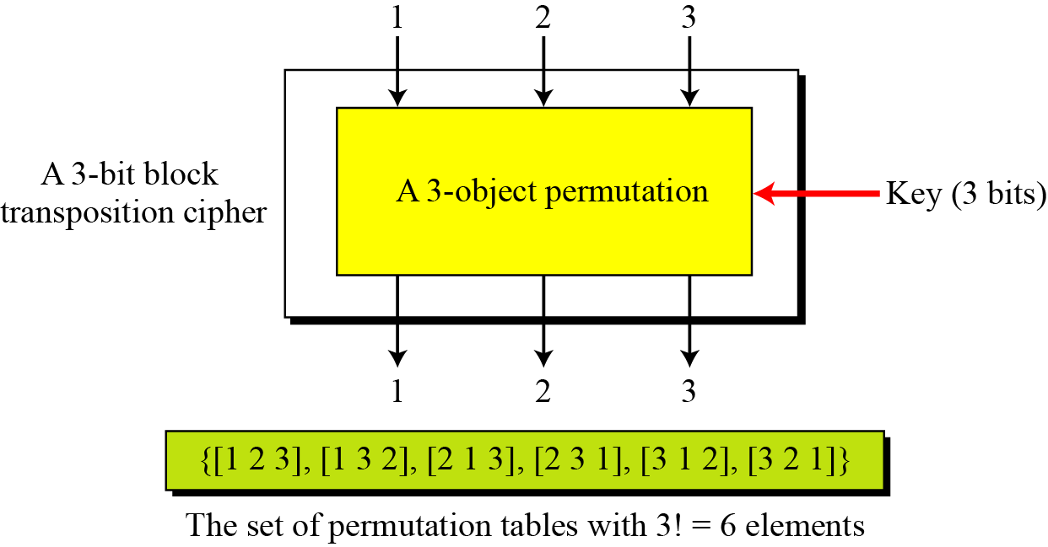
Block Ciphers as Permutation Groups...

Slide 12
Block Ciphers as Permutation Groups...
Full-Size Key substitution Block Ciphers
A full-size key substitution cipher does not transpose bits; it substitutes bits.
We can model the substitution cipher as a permutation if we can decode the input and encode the output.
Example:
Show the model and the set of permutation tables for a 3-bit block substitution cipher.
Solution
Leads to a much longer key of [log₂ (40320)]=16 bits

Slide 13
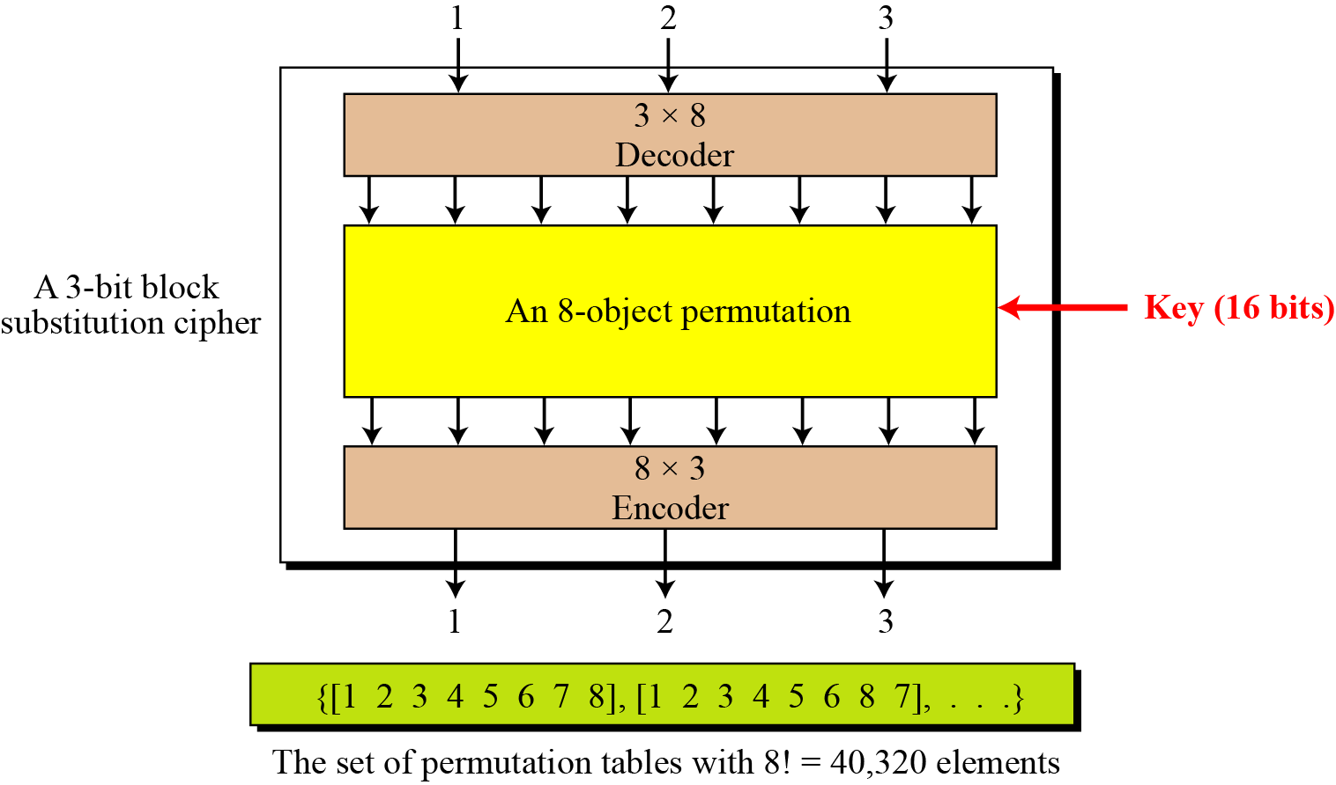
Block Ciphers as Permutation Groups...

Slide 14
Block Ciphers as Permutation Groups...
A full-size key n-bit transposition cipher or a substitution block cipher can be modeled as a permutation, but their key sizes are different:
Transposition: the key is ???
Substitution: the key is ???

Slide 15
Block Ciphers as Permutation Groups...
A full-size key n-bit transposition cipher or a substitution block cipher can be modeled as a permutation, but their key sizes are different:
Transposition: the key is log₂(n!)
Substitution: the key is log₂(2^{n}!)

Slide 16
Block Ciphers as Permutation Groups...
It is useless to have more than one stage of full size key ciphers, because the effect is the same as having a single stage
Can you justify this ???

Slide 17
Block Ciphers as Permutation Groups...
Partial size key ciphers
Actual ciphers can not use full-size keys because the size of the key becomes large
E.g. DES is a common substitution cipher with 64-bit block
If the designers of DES would have used full-size key cipher, what will be the size of a key?

Slide 18
Block Ciphers as Permutation Groups...
Analysis of full-size key ciphers
Actual ciphers can not use full-size keys because the size of the key becomes large
E.g. DES is a common substitution cipher with 64-bit block
If the designers of DES would have used full-size key cipher, what will be the size of a key?
The answer is log₂(2⁶⁴!) ≈ 2⁷⁰ bits !!!!
DES uses only 56-bit keys ….

Slide 19
Block Ciphers as Permutation Groups...
Partial-size key ciphers
Is a group under the composition operation if it is a subgroup of the corresponding full-size cipher
Can a multistage version of a partial-size key cipher be made to achieve more security?

Slide 20
Components of a Modern Block Cipher
Modern block ciphers normally are keyed substitution ciphers in which the key allows only partial mappings from the possible inputs to the possible outputs.
P-Boxes
A P-box (permutation box) parallels the traditional transposition cipher for characters.
It transposes bits.

Slide 21
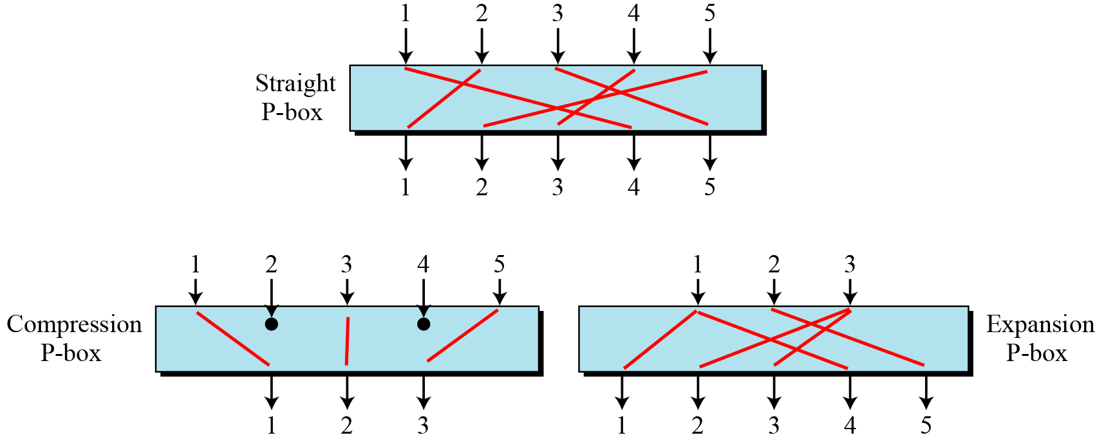
Components of a Modern Block Cipher...

Slide 22
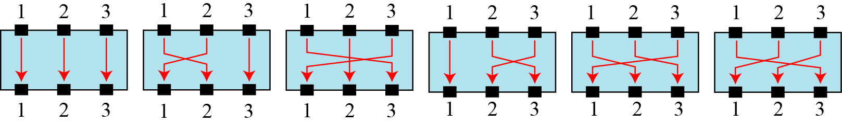
Components of a Modern Block Cipher...
Possible mappings of a P-Box

Slide 23
Components of a Modern Block Cipher...
Straight P-Box

Slide 24
Components of a Modern Block Cipher...
Example
Design an 8 × 8 permutation table for a straight P-box that moves the two middle bits (bits 4 and 5) in the input word to the two ends (bits 1 and 8) in the output words. Relative positions of other bits should not be changed.

Slide 25
Components of a Modern Block Cipher...
Example
Design an 8 × 8 permutation table for a straight P-box that moves the two middle bits (bits 4 and 5) in the input word to the two ends (bits 1 and 8) in the output words. Relative positions of other bits should not be changed.
Solution
We need a straight P-box with the table [4 1 2 3 6 7 8 5].

Slide 26
Components of a Modern Block Cipher...
Compression P-Boxes
A compression P-box is a P-box with n inputs and m outputs where m < n.
Example of a 32 x 24 permutation table

Slide 27
Components of a Modern Block Cipher...
Expansion P-Boxes
An expansion P-box is a P-box with n inputs and m outputs where m > n.
Example of a 12 X 16 P-Box

Slide 28
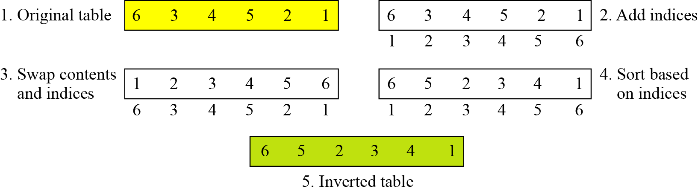
Components of a Modern Block Cipher...
P-Box invertibility
What can you say about this???
A straight P-box is invertible, but compression and expansion P-boxes are not.
Inverting a permutation table represented as a one-dimensional table.

Slide 29
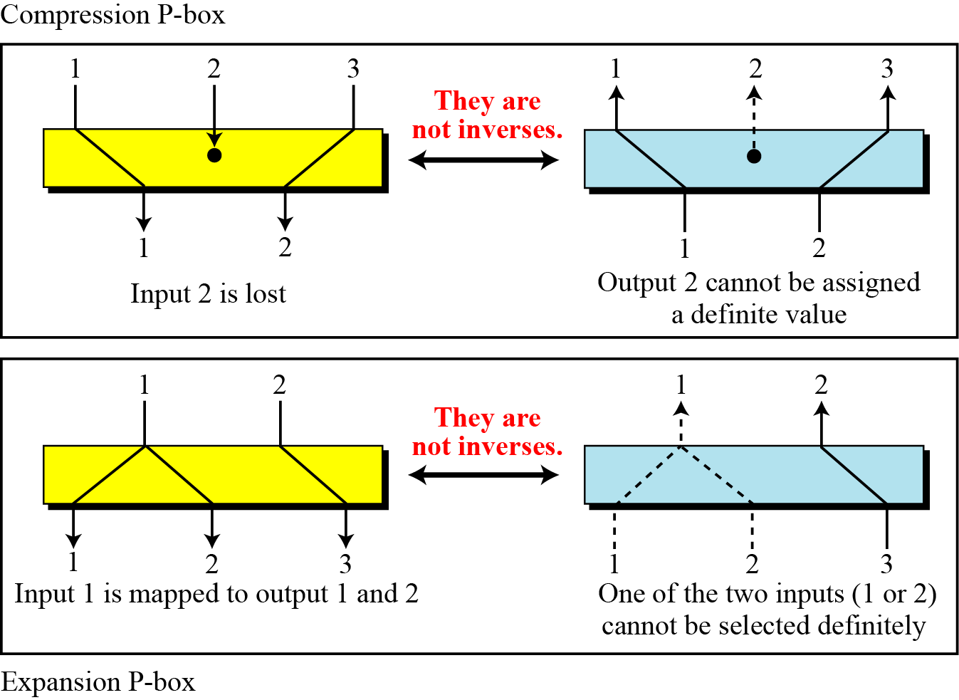
Components of a Modern Block Cipher...
Compression and expansion P-boxes are non-invertible

Slide 30
Components of a Modern Block Cipher...
S-Box
An S-box (substitution box) can be thought of as a miniature substitution cipher.
An S-box is an m × n substitution unit, where m and n are not necessarily the same.
Example
In an S-box with three inputs and two outputs, we have,

Slide 31
Components of a Modern Block Cipher...
S-Box
The S-box is linear because a_{1,1} = a_{1,2} = a_{1,3} = a_{2,1} = 1 and a_{2,2} = a_{2,3} = 0. The relationship can be represented by matrices, as shown below:

Slide 32
Components of a Modern Block Cipher...
S-Box
In an S-box with three inputs and two outputs, we have
where multiplication and addition is in GF(2). The S-box is nonlinear because there is no linear relationship between the inputs and the outputs.

Slide 33
Components of a Modern Block Cipher...
Example
The following table defines the input/output relationship for an S-box of size 3 × 2. The leftmost bit of the input defines the row; the two rightmost bits of the input define the column. The two output bits are values on the cross section of the selected row and column.
Based on the table, an input of 010 yields the output 01. An input of 101 yields the output of 00.

Slide 34
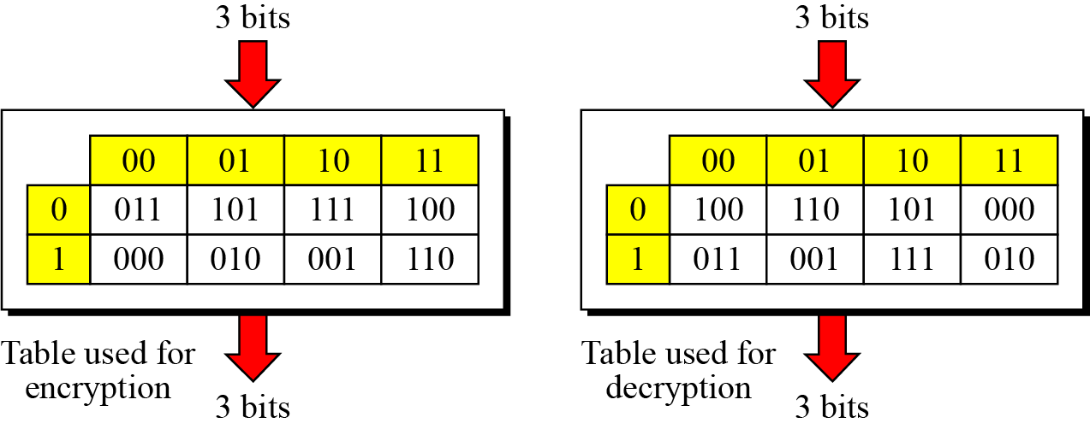
Components of a Modern Block Cipher...
S-Box Invertibility
An S-box may or may not be invertible.
In an invertible S-box, the number of input bits should be the same as the number of output bits.

Slide 35
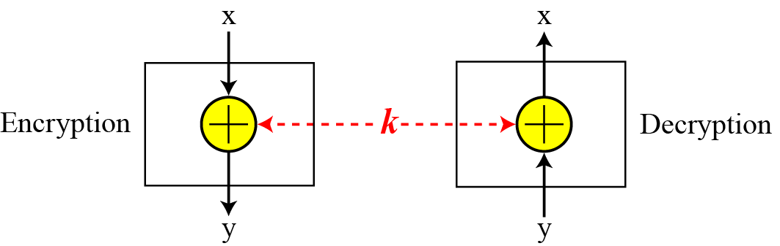
Components of a Modern Block Cipher...
Exclusive-Or

Slide 36
Components of a Modern Block Cipher...
Exclusive-Or...
An important component in most block ciphers is the exclusive-or operation.
Addition and subtraction operations in the GF(2^{n}) field are performed by a single operation called the exclusive-or (XOR).
The five properties of the exclusive-or operation in the GF(2^{n}) field makes this operation a very interesting component for use in a block cipher: closure, associativity, commutativity, existence of identity, and existence of inverse.

Slide 37
Components of a Modern Block Cipher...
Exclusive-Or...
The inverse of a component in a cipher makes sense if the component represents a unary operation (one input and one output).
For example, a keyless P-box or a keyless S-box can be made invertible because they have one input and one output.
An exclusive operation is a binary operation. The inverse of an exclusive-or operation can make sense only if one of the inputs is fixed (is the same in encryption and decryption).
For example, if one of the inputs is the key, which normally is the same in encryption and decryption, then an exclusive-or operation is self-invertible

Slide 38
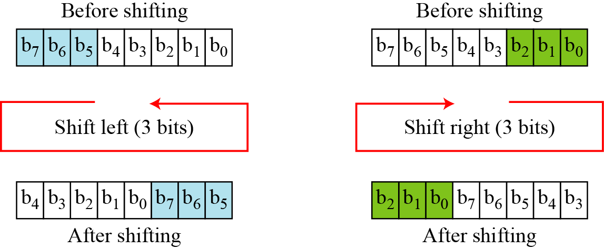
Components of a Modern Block Cipher...
Circular Shift operation

Slide 39
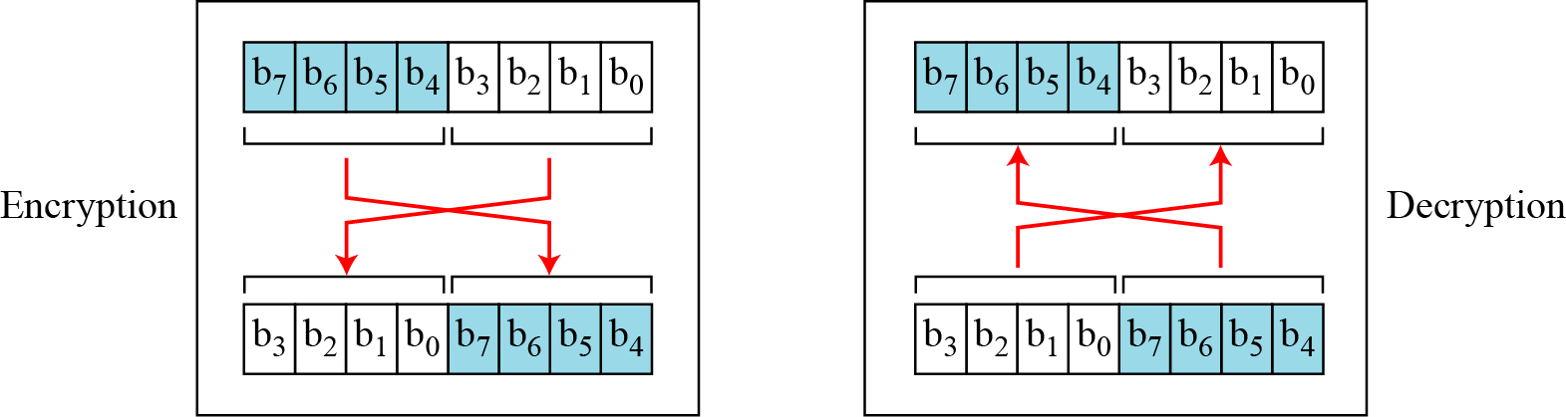
Components of a Modern Block Cipher...
Swap
The swap operation is a special case of the circular shift operation where k = n/2.

Slide 40
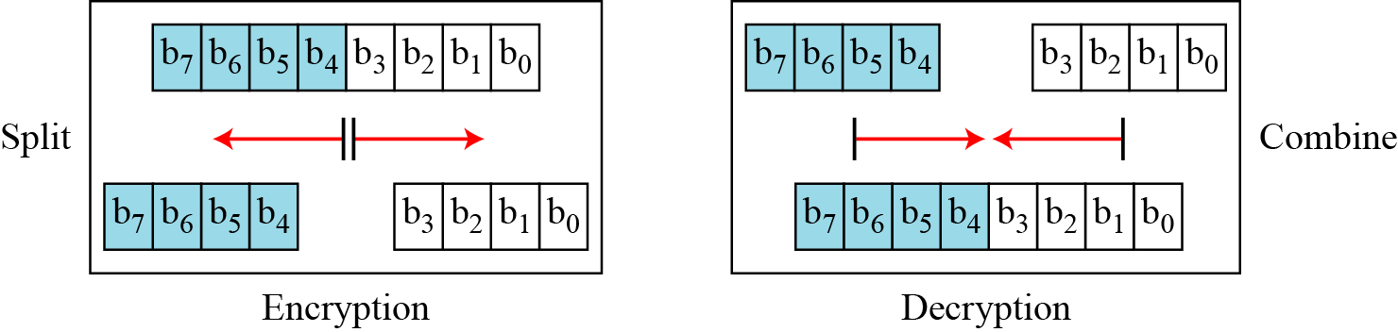
Components of a Modern Block Cipher...
Split and Combine
Two other operations found in some block ciphers are split and combine.

Slide 41
Product cipher
Shannon introduced the concept of a product cipher.
A product cipher is a complex cipher combining substitution, permutation, and other components

Slide 42
Product cipher...
Diffusion
The idea of diffusion is to hide the relationship between the ciphertext and the plaintext.
Confusion
The idea of confusion is to hide the relationship between the ciphertext and the key.
Diffusion and confusion can be achieved using iterated product ciphers where each iteration is a combination of S-boxes, P-boxes, and other components.

Slide 43
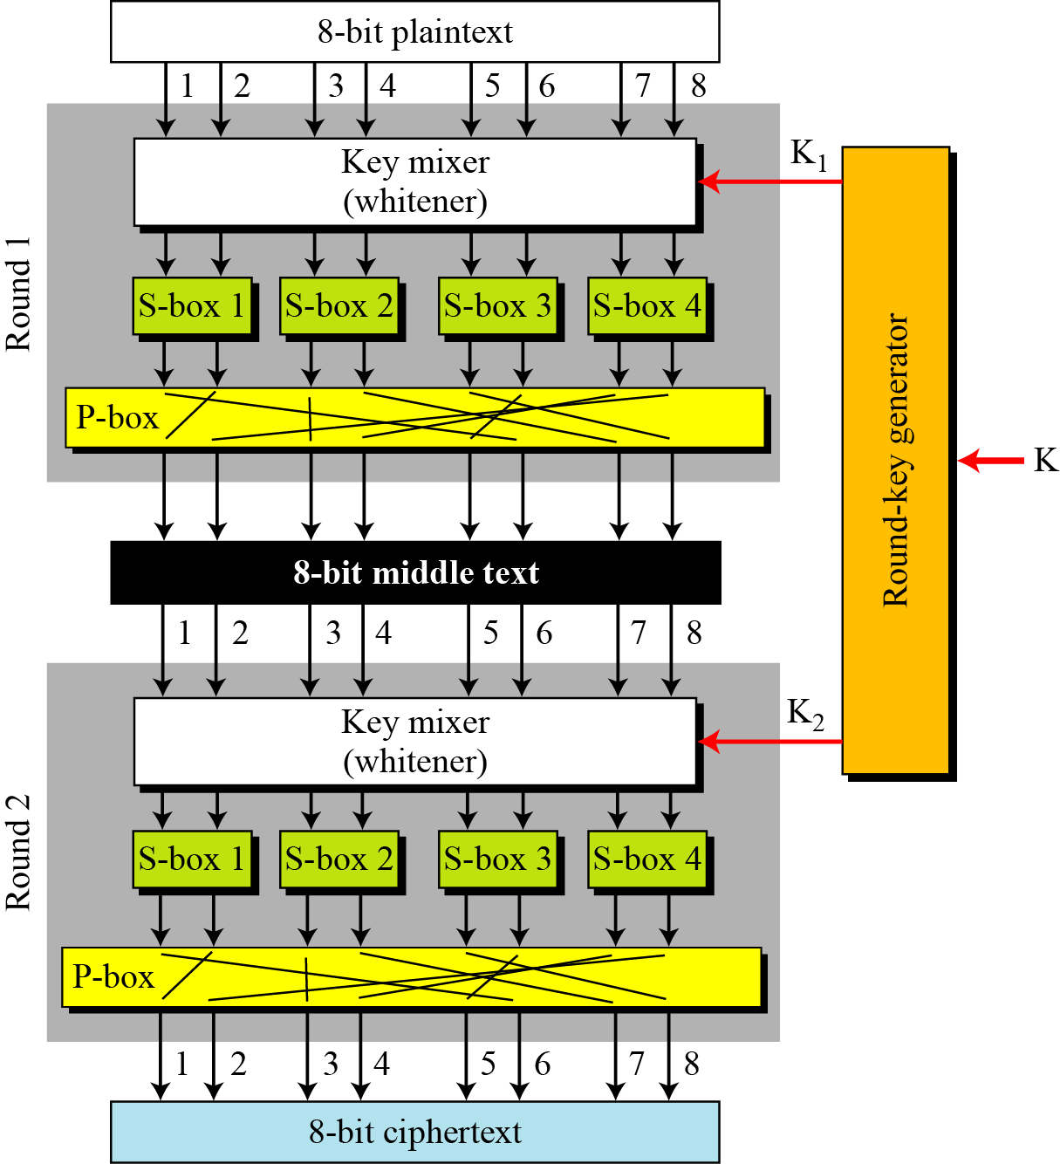
Product cipher...

Slide 44
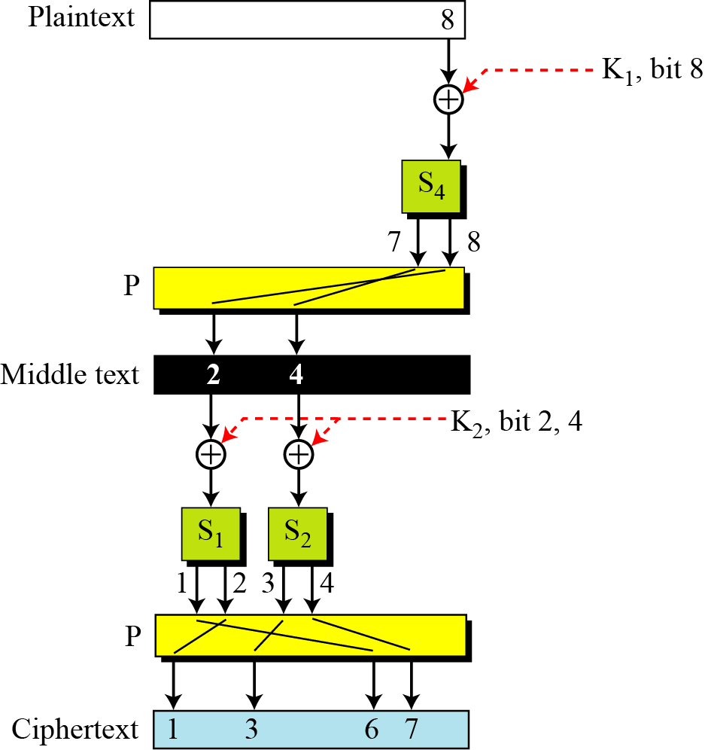
Product cipher...

Slide 45
Two classes of product ciphers
Modern block ciphers are all product ciphers, but they are divided into two classes.
Feistel ciphers
Non-Feistel ciphers

Slide 46
Two classes of product ciphers...
Feistel Ciphers
Feistel designed a very intelligent and interesting cipher that has been used for decades.
A Feistel cipher can have three types of components: self-invertible, invertible, and noninvertible.

Slide 47
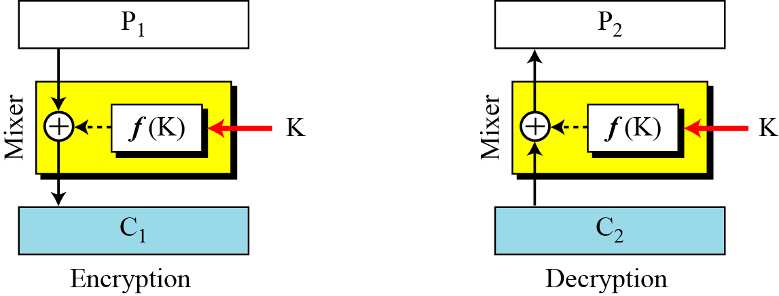
Two classes of product ciphers...
The first thought in Feistel Cipher design

Slide 48
Two classes of product ciphers...
Example
The plaintext and ciphertext are each 4 bits long and the key is 3 bits long. Assume that the function takes the first and third bits of the key, interprets these two bits as a decimal number, squares the number, and interprets the result as a 4-bit binary pattern. Show the results of encryption and decryption if the original plaintext is 0111 and the key is 101.

Slide 49
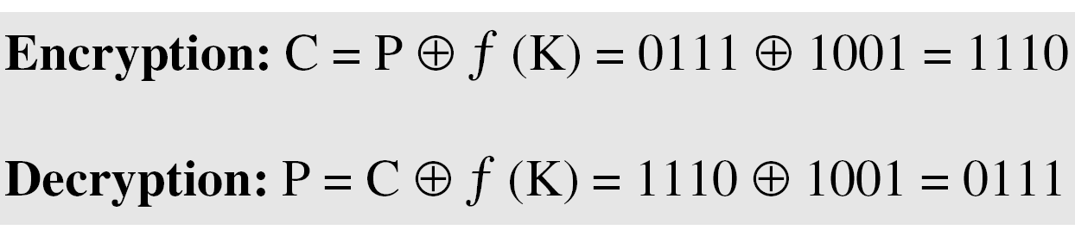
Two classes of product ciphers...
Solution
The function extracts the first and second bits to get 11 in binary or 3 in decimal. The result of squaring is 9, which is 1001 in binary.

Slide 50
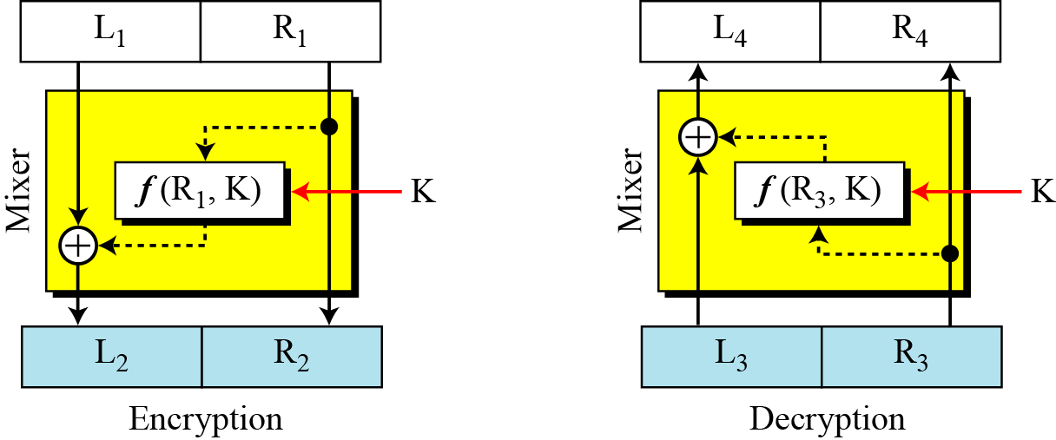
Two classes of product ciphers...
Improvement in previous design

Slide 51
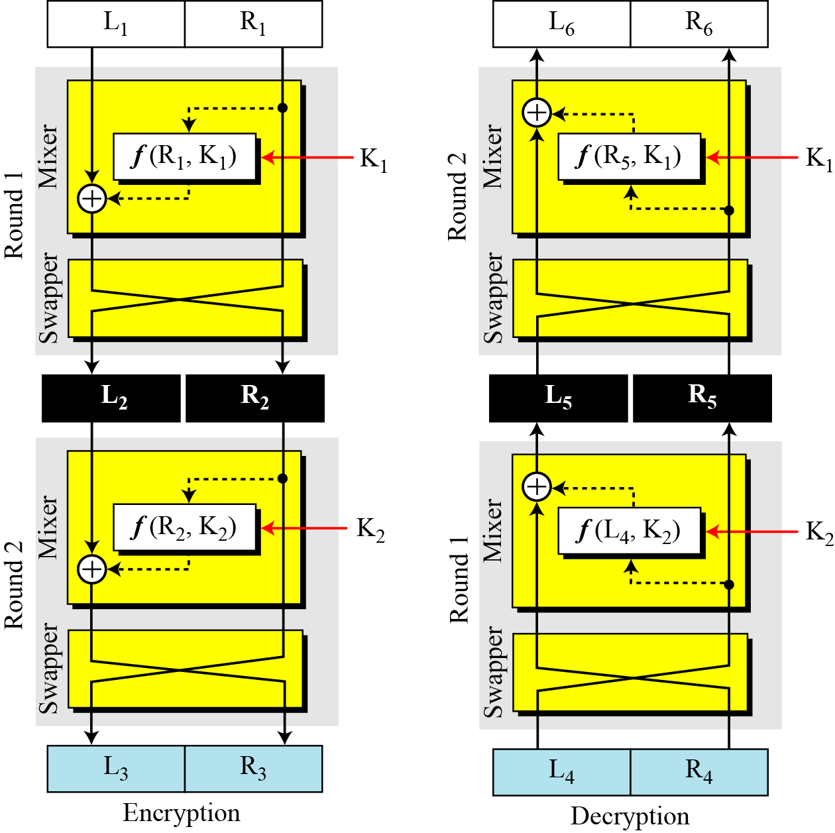
Final design of a fiestel cipher...

Slide 52
Final design of a fiestel cipher...
Non-fiestel cipher
Used on invertible components
A component in the encryption cipher has the corresponding component in the decryption cipher.

Slide 53
Attacks on modern ciphers
Attacks on traditional ciphers can also be used on modern block ciphers, but today’s block ciphers resist most of the attacks that are possible in classical ciphers

Slide 54
Data Encryption Standard (DES)
t

Slide 55
Introduction
The Data Encryption Standard (DES) is a symmetric-key block cipher published by the National Institute of Standards and Technology (NIST).
In 1973, NIST published a request for proposals for a national symmetric-key cryptosystem. A proposal from IBM, a modification of a project called Lucifer, was accepted as DES. DES was published in the Federal Register in March 1975 as a draft of the Federal Information Processing Standard (FIPS).

Slide 56
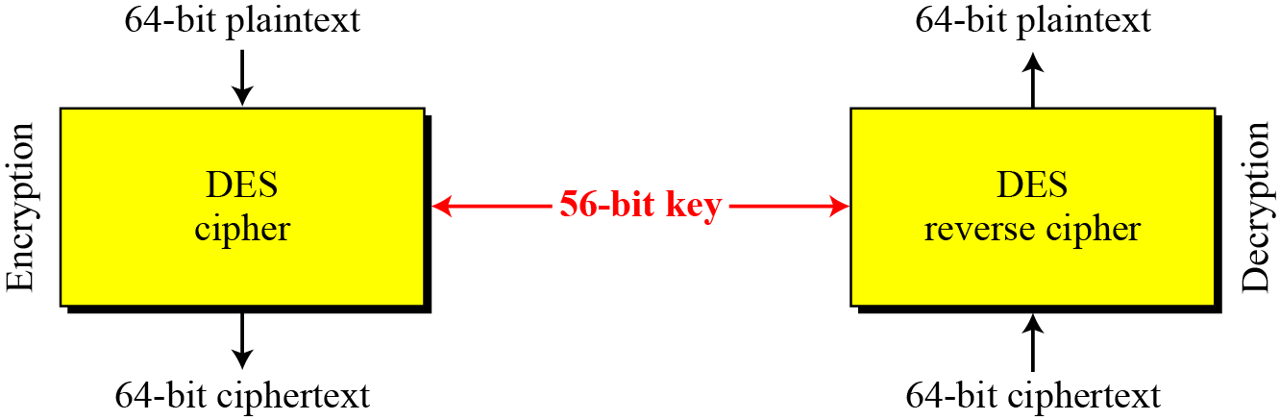
Overview

Slide 57
Structure of DES
The encryption process is made of two permutations (P-boxes), which we call initial and final permutations, and sixteen Feistel rounds.

Slide 58
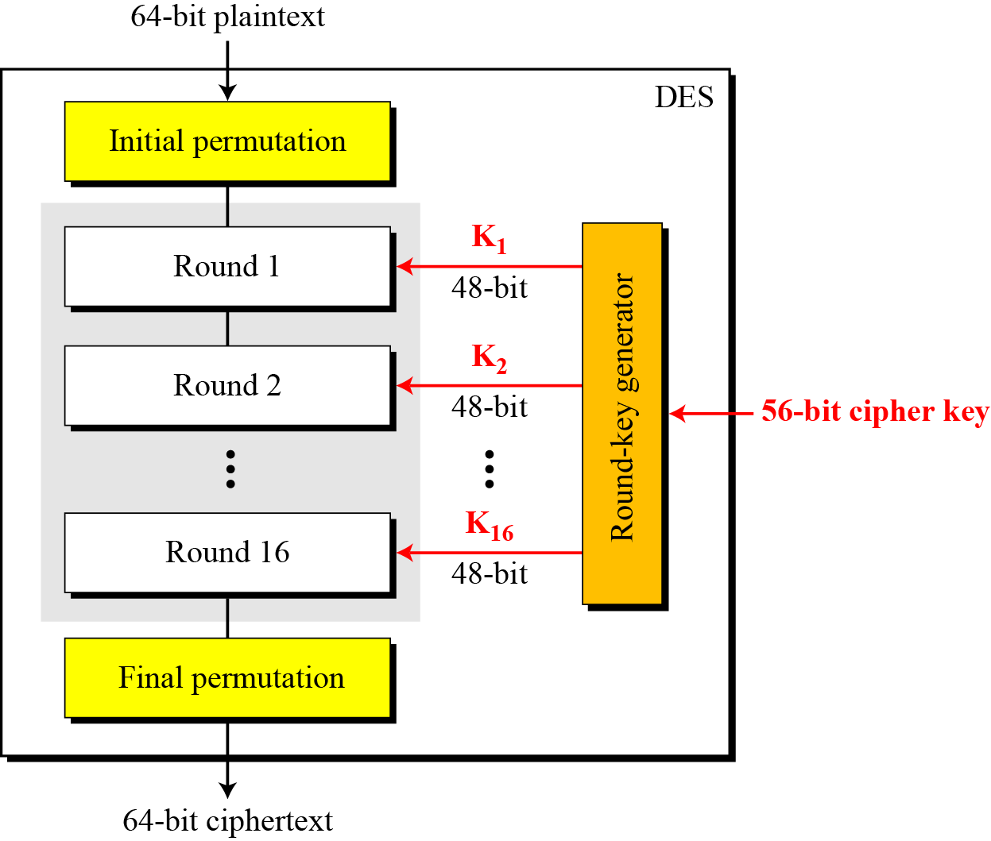
Structure of DES...

Slide 59
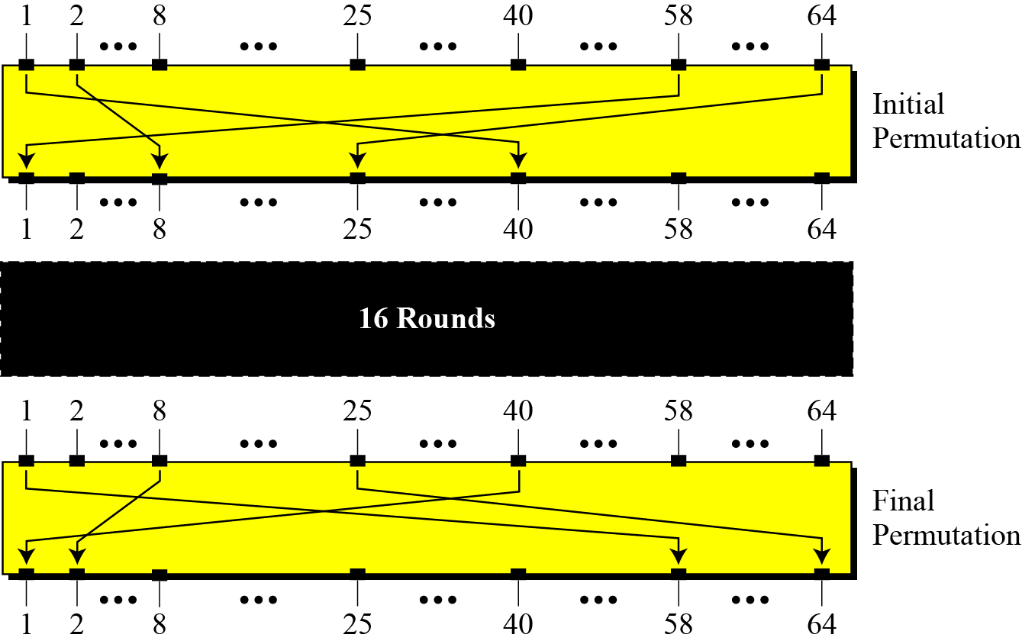
Initial and Final permutations

Slide 60
Initial and Final permutations...

Slide 61
Initial and Final permutations...
Find the output of the initial permutation box when the input is given in hexadecimal as:

Slide 62
Initial and Final permutations...
Find the output of the initial permutation box when the input is given in hexadecimal as:
Solution:

Slide 63
Assignment questions...
Prove that the initial and final permutations are the inverse of each other by finding the output of the final permutation if the input is

Slide 64
Assignment questions...
Prove that the initial and final permutations are the inverse of each other by finding the output of the final permutation if the input is

Slide 65
Assignment questions...
The plaintext and ciphertext are each 4 bits long and the key is 3 bits long. Assume that the function takes the first and third bits of the key, interprets these two bits as a decimal number, squares the number, and interprets the result as a 4-bit binary pattern. Show the results of encryption and decryption if the original plaintext is 0111 and the key is 101.
C = P XOR f(K) and P = C XOR f(K)

Slide 66
Assignment questions...
The plaintext and ciphertext are each 4 bits long and the key is 3 bits long. Assume that the function takes the first and third bits of the key, interprets these two bits as a decimal number, squares the number, and interprets the result as a 4-bit binary pattern. Show the results of encryption and decryption if the original plaintext is 0111 and the key is 101.
C = P XOR f(K) and P = C XOR f(K)
Solution
The function extracts the first and second bits to get 11 in binary or 3 in decimal. The result of squaring is 9, which is 1001 in binary.

Slide 67
Assignment questions...
A transposition block has 10 inputs and 10 outputs. What is the order of the permutation group? What is the key size?
A substitution block has 10 inputs and 10 outputs. What is the order of the permutation group? What is the key size?
The input/output relation in a 2x2 S-box is shown by the following table. Show the table for the inverse S-box.
Input left bit/input right bit | 0 | 1
0 | 01 | 11
1 | 10 | 00

Slide 68
Assignment questions...
Show the D-box defined by the following table:
8 1 2 3 4 5 6 7

Slide 69
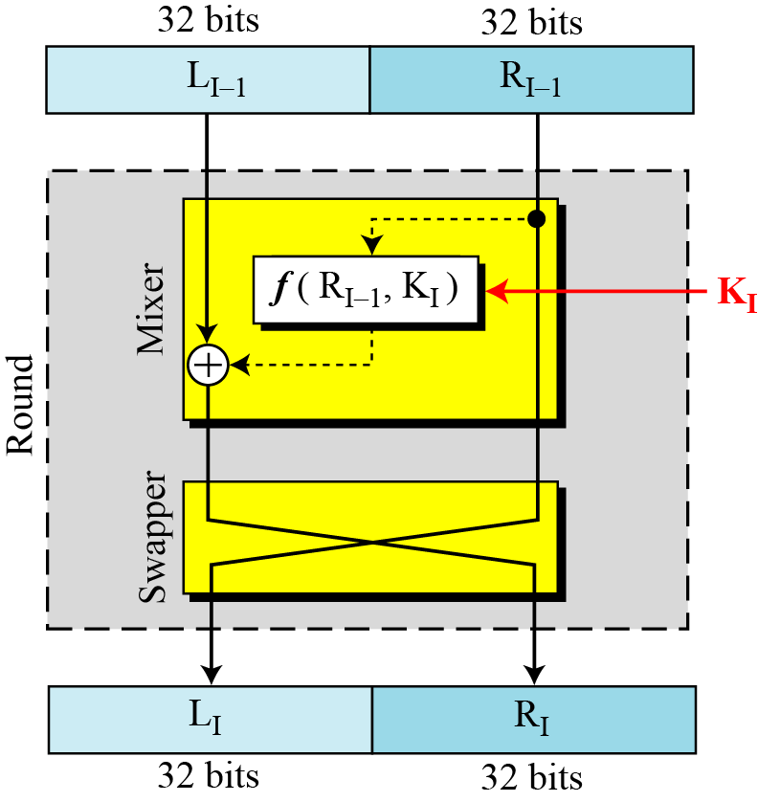
Rounds
16 rounds of Fiestel cipher

Slide 70
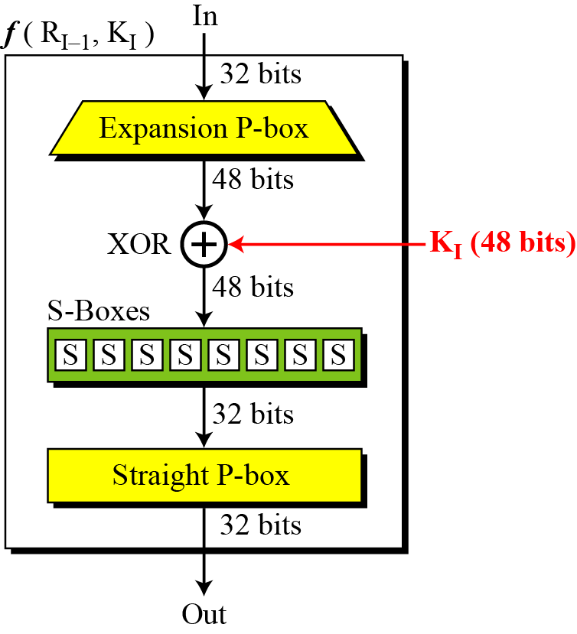
DES function

Slide 71
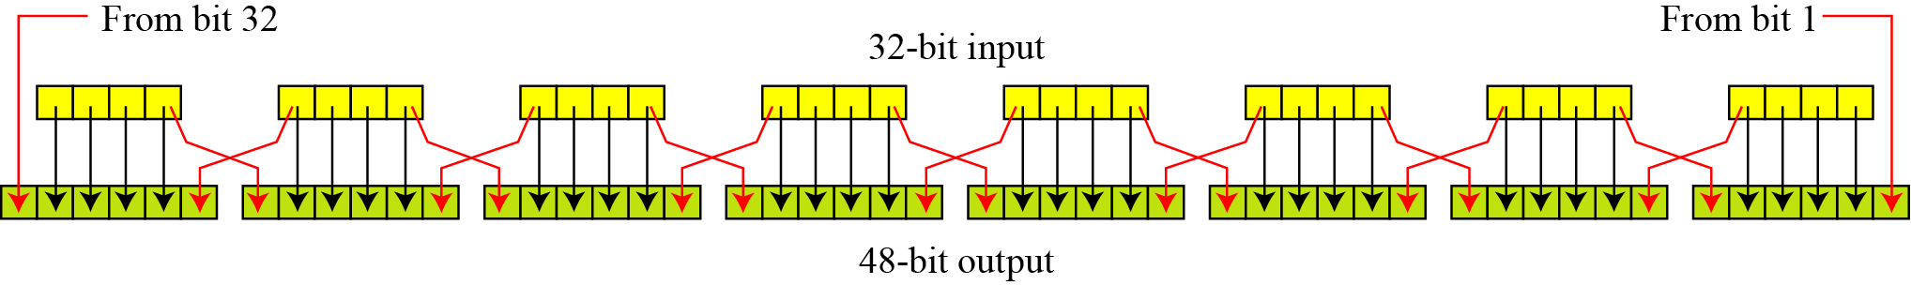
DES function…
Expansion P-box
Since R_{I−1} is a 32-bit input and K_{I} is a 48-bit key, we first need to expand R_{I−1} to 48 bits.

Slide 72
DES function…
Expansion P-box
Since R_{I−1} is a 32-bit input and K_{I} is a 48-bit key, we first need to expand R_{I−1} to 48 bits.

Slide 73
DES function…
Whitener
After the expansion permutation, DES uses the XOR operation on the expanded right section and the round key. Note that both the right section and the key are 48-bits in length. Also note that the round key is used only in this operation.

Slide 74
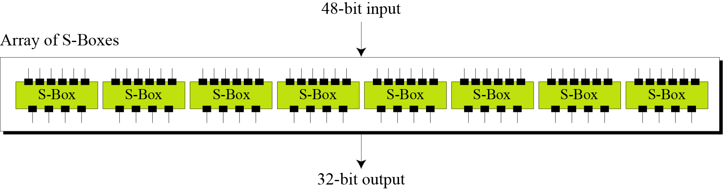
DES function…
S-Boxes

Slide 75
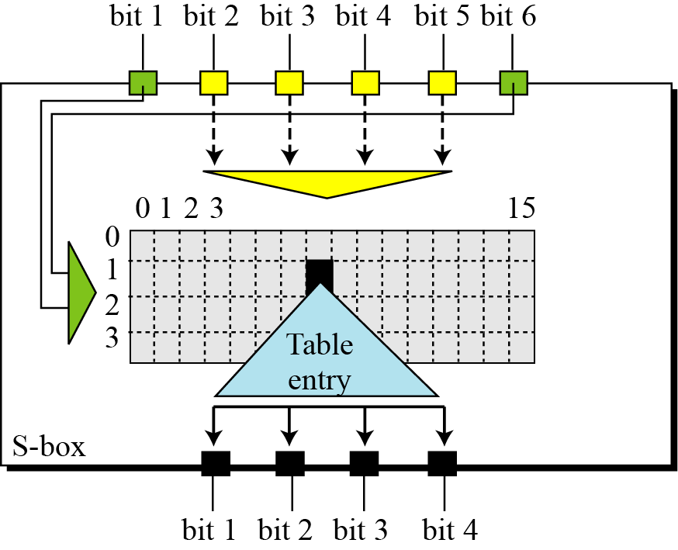
DES function…
S-Boxes

Slide 76
DES function…
Permutations for S-Box-I

Slide 77
DES function…
Example
The input to S-box 1 is 100011. What is the output?

Slide 78
DES function…
Example
The input to S-box 1 is 100011. What is the output?
Solution
If we write the first and the sixth bits together, we get 11 in binary, which is 3 in decimal. The remaining bits are 0001 in binary, which is 1 in decimal. We look for the value in row 3, column 1, in Table of S-box 1. The result is 12 in decimal, which in binary is 1100. So the input 100011 yields the output 1100.

Slide 79
DES function…
Straight P-Box

Slide 80
Cipher and reverse cipher
Using mixers and swappers, we can create the cipher and reverse cipher, each having 16 rounds.
First Approach
To achieve this goal, one approach is to make the last round (round 16) different from the others; it has only a mixer and no swapper.

Slide 81
Cipher and reverse cipher...
16 rounds of Fiestel cipher

Slide 82
Cipher and reverse cipher...
Alternative approach
We can make all 16 rounds the same by including one swapper to the 16th round and add an extra swapper after that.

Slide 83
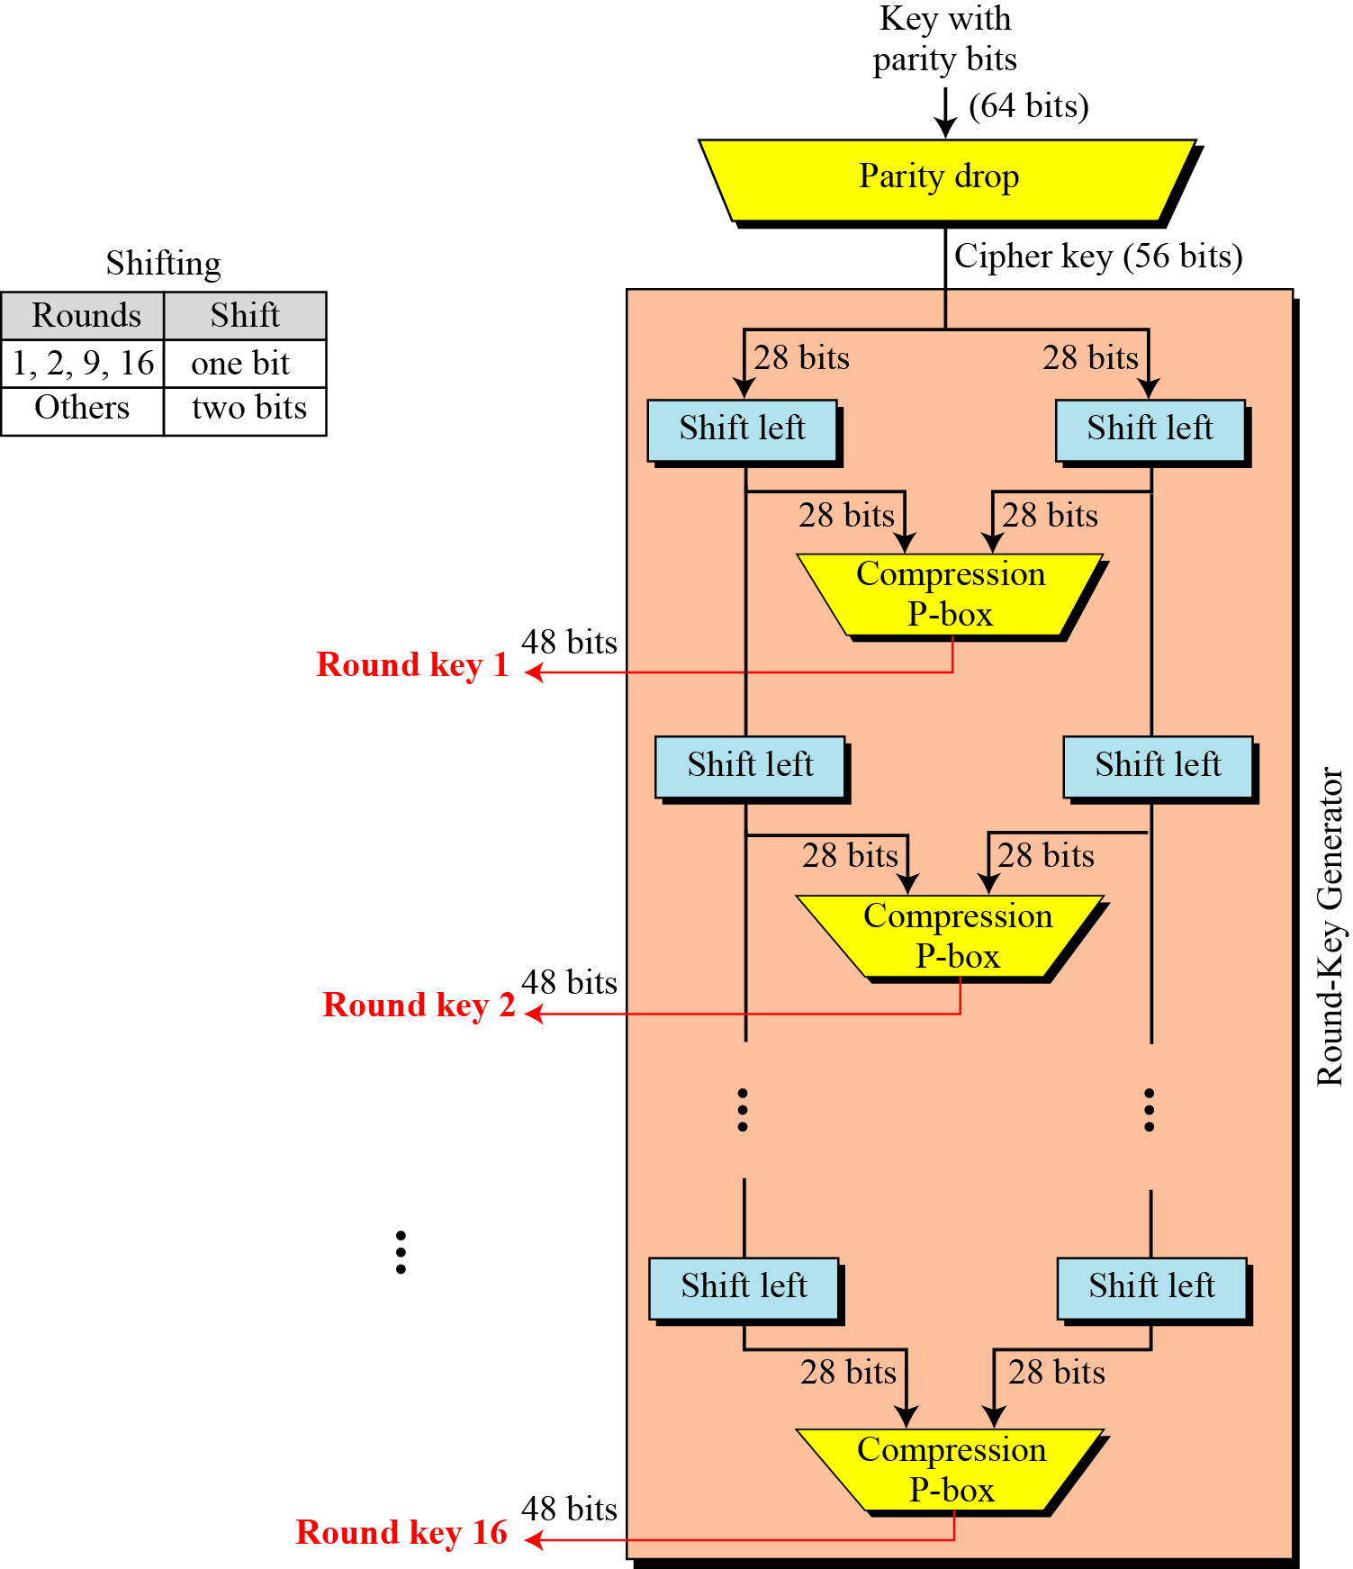
Key generation
The round-key generator creates sixteen 48-bit keys out of a 56-bit cipher key.

Slide 84
Key generation
Parity bit drop table
Number of shift bits

Slide 85
Key generation
Key compression table

Slide 86
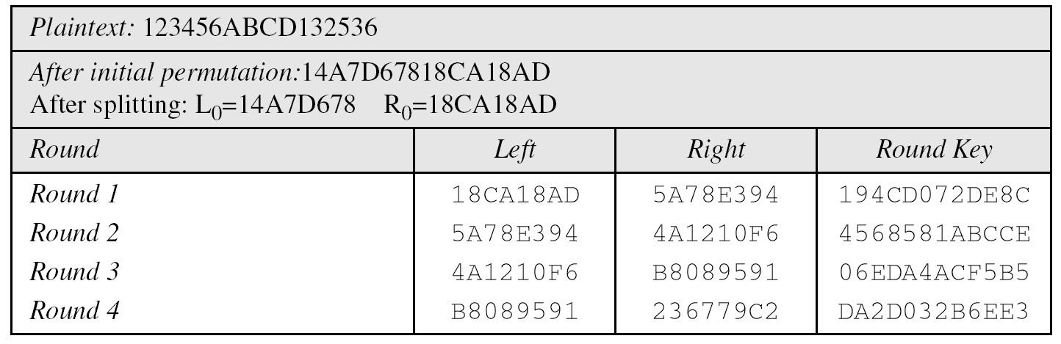
DES: an example of encipherment

Slide 87
DES: an example of encipherment...

Slide 88
DES: an example of decipherment

Slide 89
DES: Analysis
Two desirable properties
Avalanche effect
Completeness

Slide 90
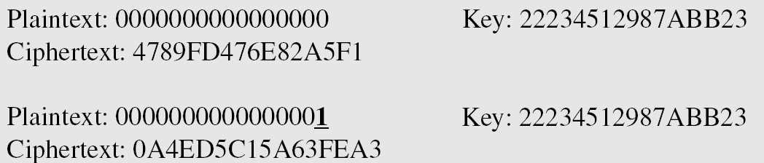
Avalanche effect
To check the avalanche effect in DES, let us encrypt two plaintext blocks (with the same key) that differ only in one bit and observe the differences in the number of bits in each round.

Slide 91
Avalanche effect...
Ciphertext blocks differ in 29 bits.
i.e. changing approximately 1.5 percent of the plaintext creates a change of approximately 45 percent in the ciphertext.

Slide 92
Completeness
Completeness effect means that each bit of the ciphertext needs to depend on many bits on the plaintext.
S-Box
P-Box
16 rounds of fiestel blocks

Slide 93
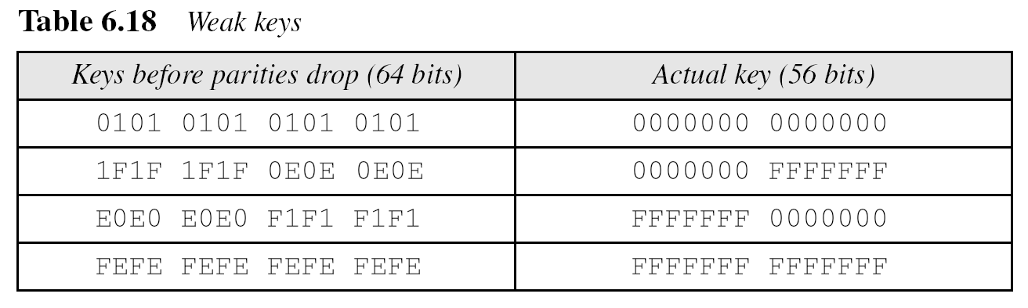
DES Weaknesses
Weakness in key

Slide 94
Key generation

Slide 95
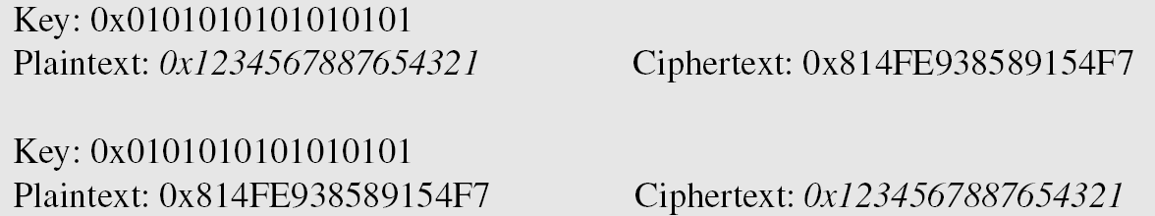
DES Weaknesses...
Example
After two encryptions with the same key the original plaintext block is created. Note that we have used the encryption algorithm two times, not one encryption followed by another decryption.

Slide 96
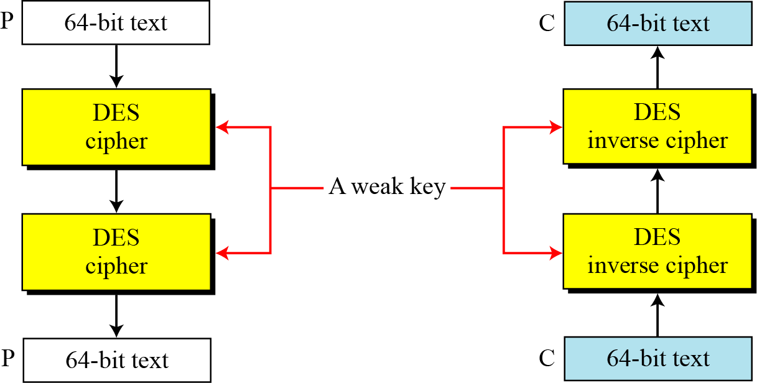
DES Weaknesses...
Double encryption and decryption with a weak key

Slide 97
DES Weaknesses...
Semi weak keys

Slide 98
DES Weaknesses...
Semi weak keys...

Slide 99
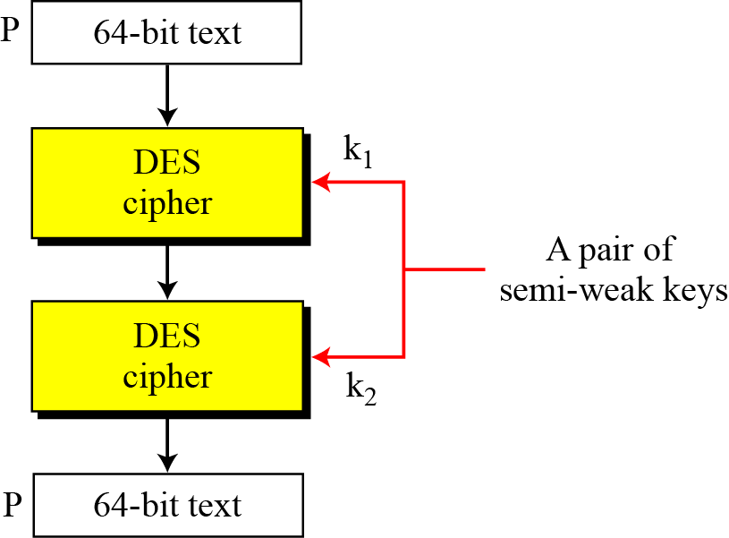
DES Weaknesses...
A pair of semi-weak keys in encryption and decryption

Slide 100
DES Weaknesses...
What is the probability of randomly selecting a weak, a semi-weak, or a possible weak key?
DES has a key domain of 256. The total number of the above keys are 64 (4 + 12 + 48). The probability of choosing one of these keys is 8.8 × 10⁻¹⁶, almost impossible.

Slide 101
DES Weaknesses...
Key complement

Slide 102
DES Weaknesses...
Key complement example

Slide 103
Multiple DES
The major criticism of DES
its key length.
Fortunately DES is not a group.
This means that we can use double or triple DES to increase the key size.

Slide 104
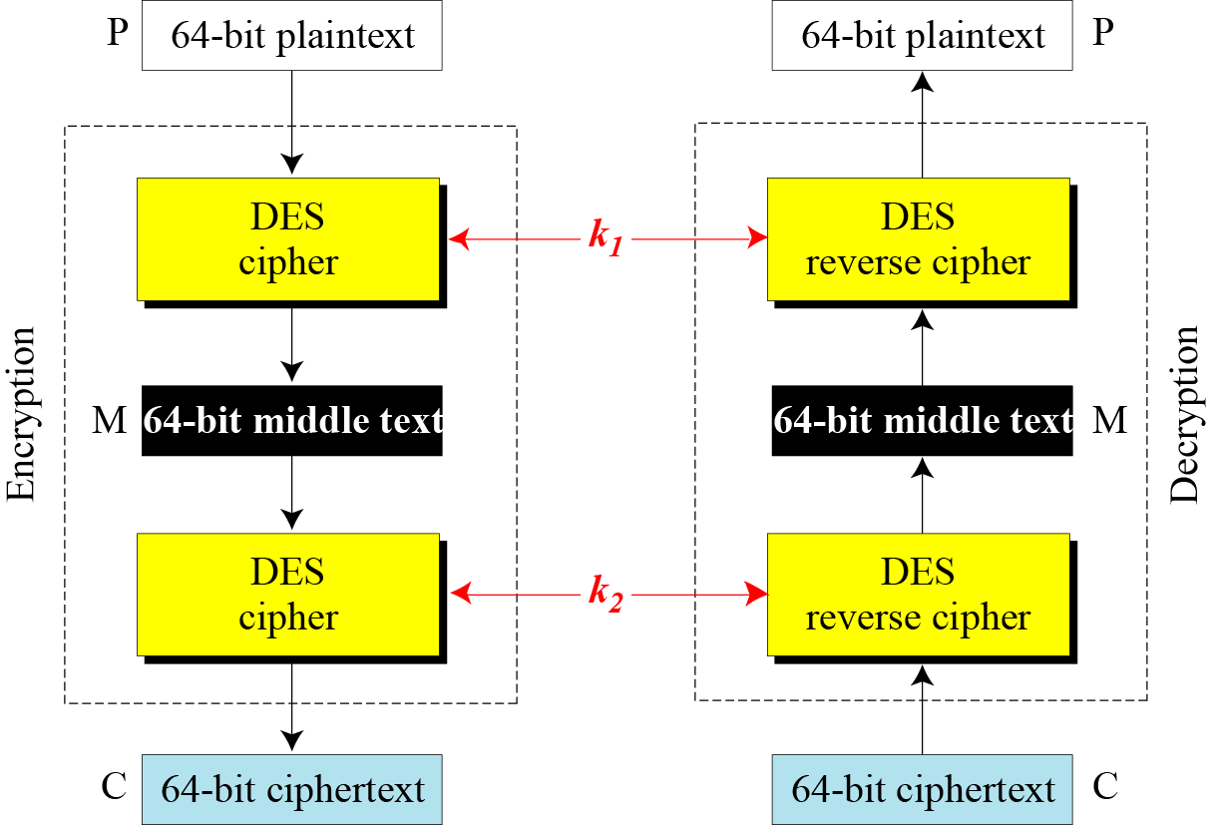
Double DES

Slide 105
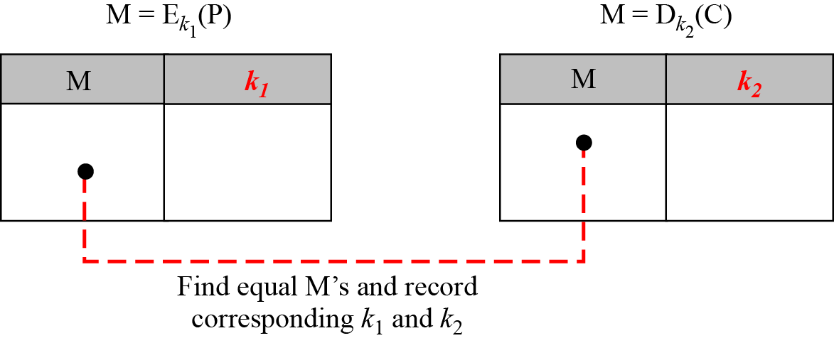
Double DES
Meet-in-the-Middle Attack
a known-plaintext attack
double DES improves this vulnerability slightly (to 2⁵⁷ tests), but not tremendously (to 2¹¹²).

Slide 106
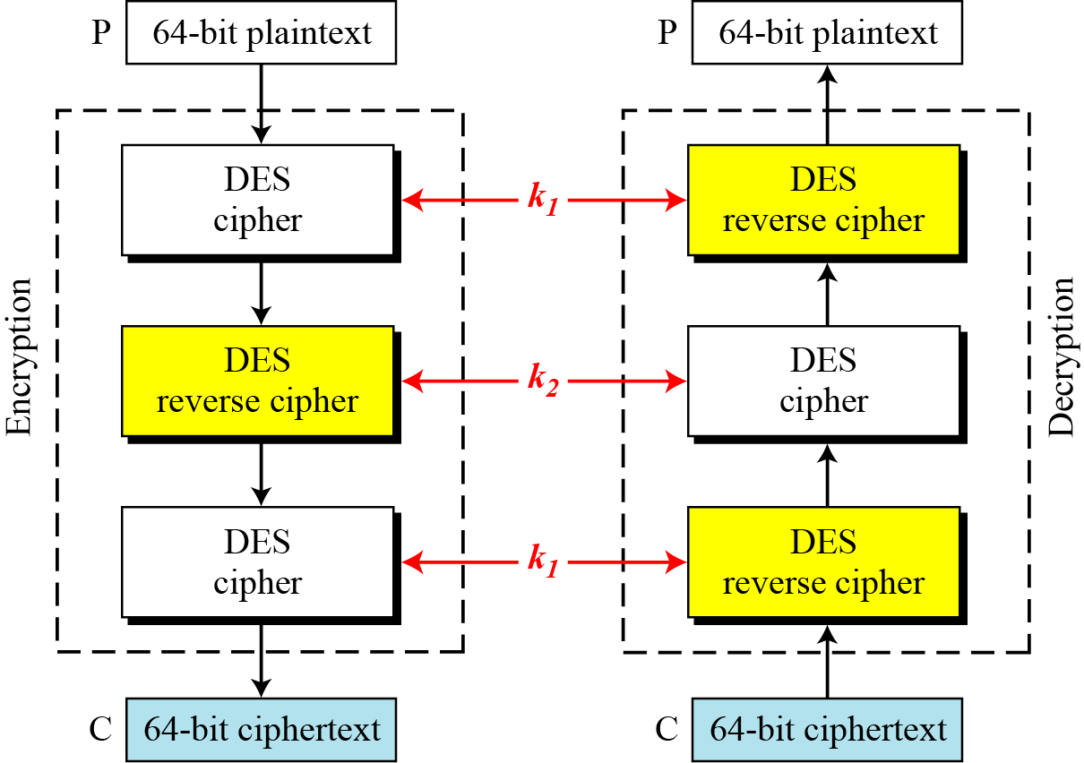
Triple DES

